Slide 1
Parallel and Distributed Computing
CS3006
Lecture 12
Basic Communication Operations-II

Slide 2
All-to-All Broadcast and All-to-All Reduction
Notes:
Permute the matrix→ use 2d block distribution

Slide 3
Basic Communication Operations (All-to-All Broadcast and All-to-All Reduction)
All-to-All Broadcast
A generalization to of one-to-all broadcast.
Every process broadcasts m-word message.
The broadcast-message for each of the processes can be different than others
All-to-All Reduction
Dual of all-to-all broadcast
Each node is the destination of an all-to-one reduction out of total P reductions.
Notes:
Applications in different matrix operations including matrix multiplication and matrix-vector multiplication

Slide 4
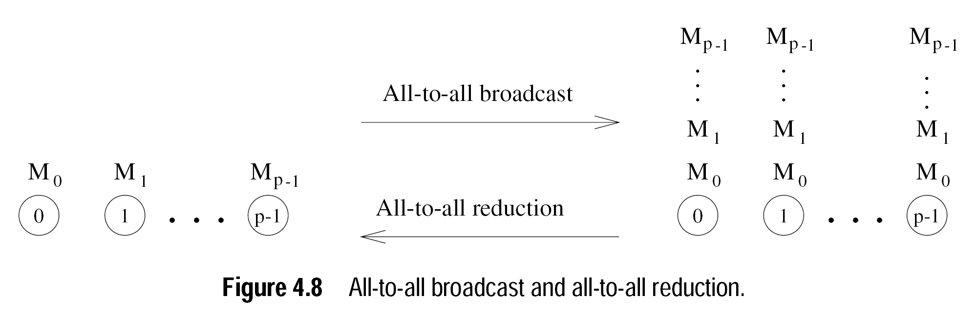
Basic Communication Operations (All-to-All Broadcast and All-to-All Reduction)
A naïve Broadcast method may be performing P one-to-all broadcasts. This will result P( log(p)(t(s) + mt(w)) ) communication time.
Solution?
Notes:
Reduction: let’s say every node has generated different P random numbers. The problem is to sum the respective indices and store it to respective process
Solution: It is possible to use the communication links in the interconnection network more efficiently by performing all p one-to-all broadcasts simultaneously so that all messages traversing the same path at the same time are concatenated into a single message whose size is the sum of the sizes of individual messages.

Slide 5
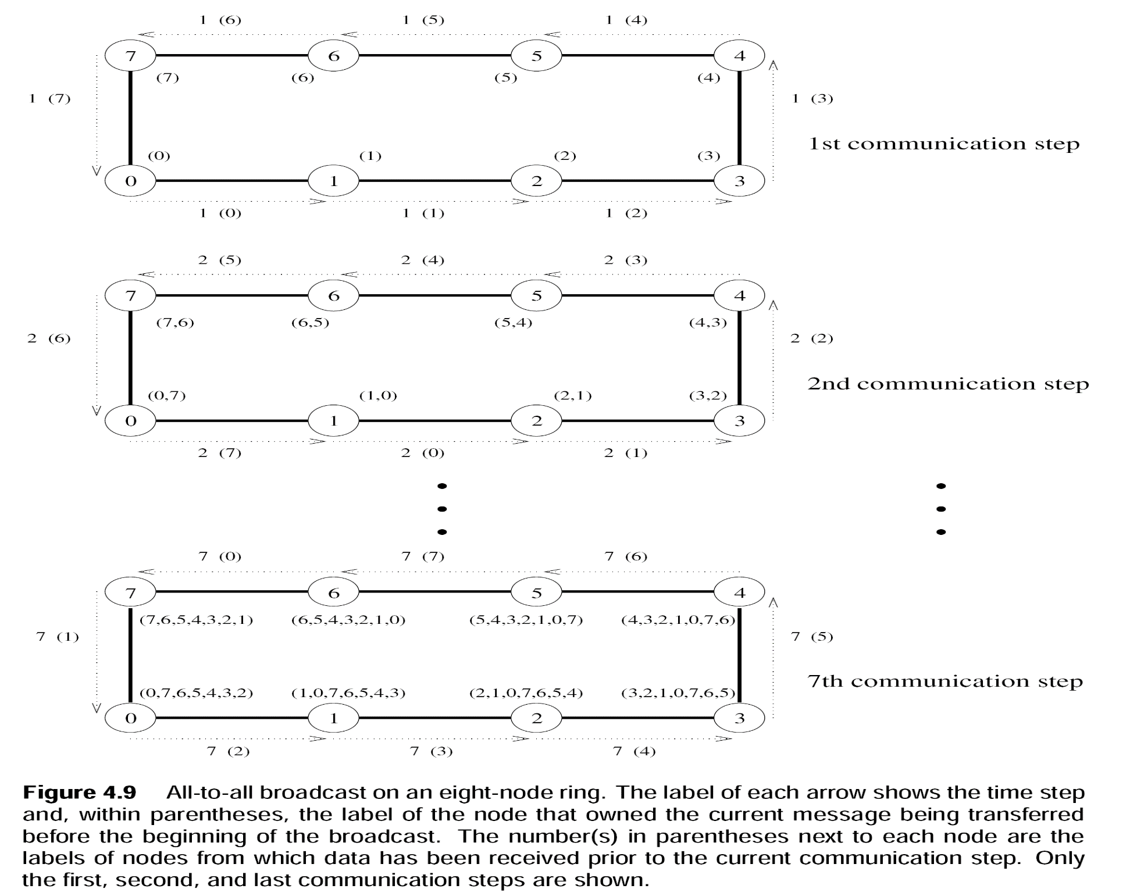
Linear Ring Broadcast

Slide 6
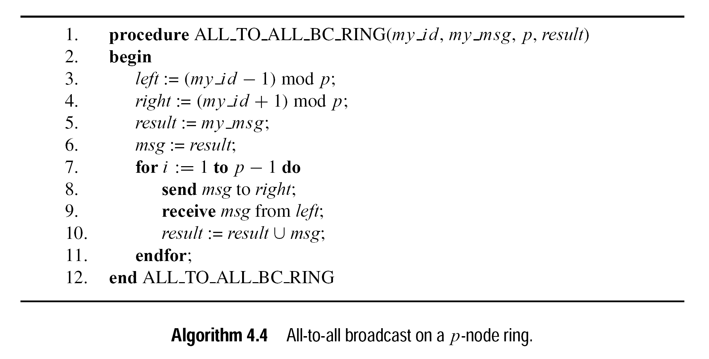
Linear Ring Broadcast
Notes:
At any node my-id is the value or label of that node
The initial message to be broadcast is known locally as my_msg at each node
At the end of the procedure, each node stores the collection of all p messages in result

Slide 7
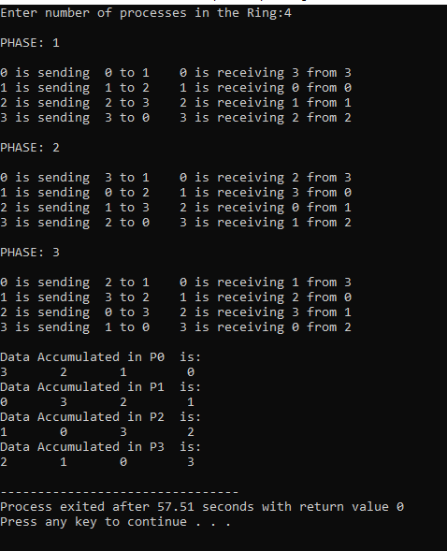
Linear Ring Broadcast
Home Task (graded as extra bonus)
Notes:
Write a program that takes number of processes in the ring from user and generates the following output.
You can take help from the algorithm described in the book.

Slide 8
Basic Communication Operations (All-to-All Broadcast and All-to-All Reduction)
Linear Array or Ring
Reduction
Draw an All-to-All Broadcast on a P-node linear ring
Reverse the directions in each foreach of the step without changing message
After each communication step, combine messages having same broadcast destination with associative operator.
Now, Its your turn to draw?
Draw an All-to-All Broadcast on a 4-node linear ring
Reverse the directions and combine the results using ‘SUM’

Slide 9
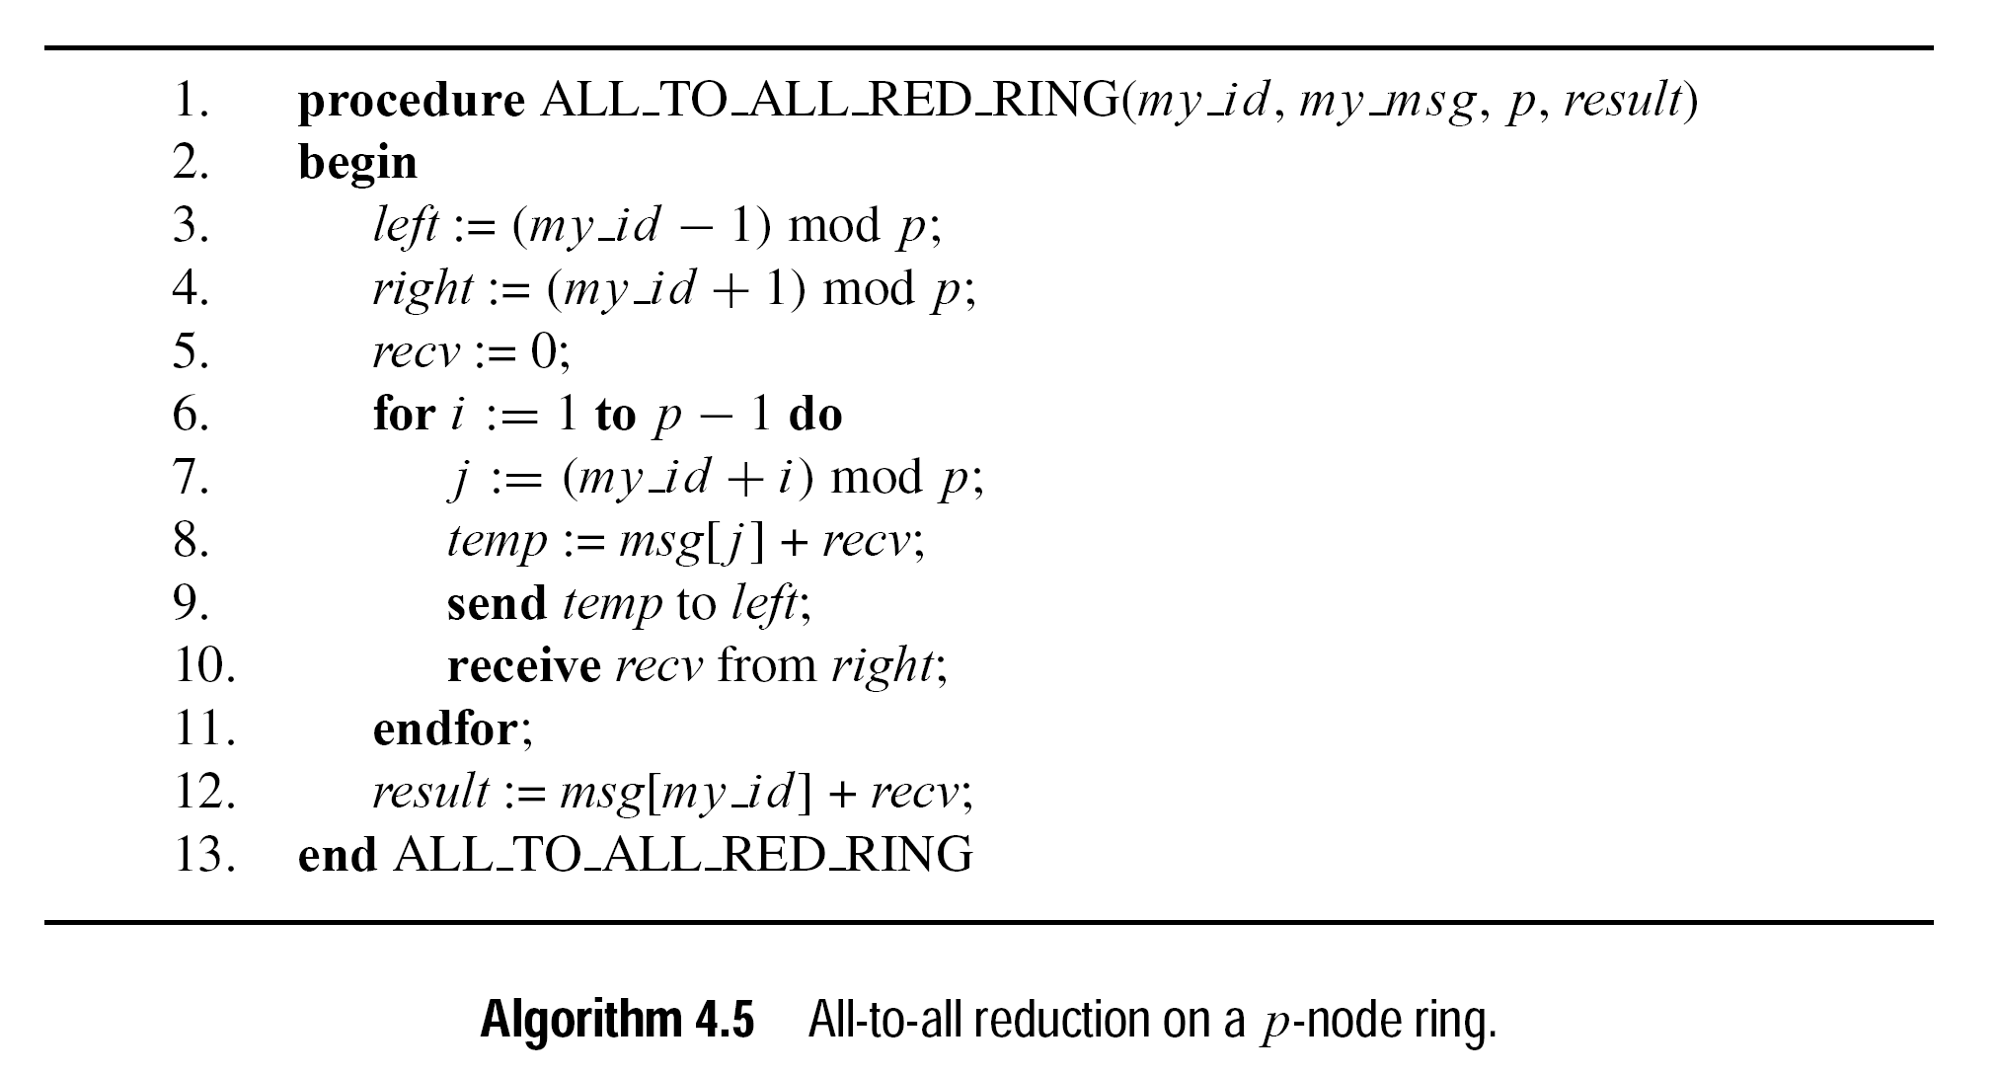
Linear Ring Reduction
Notes:
Result is a list that can accumulate all the messages received one by on

Slide 10
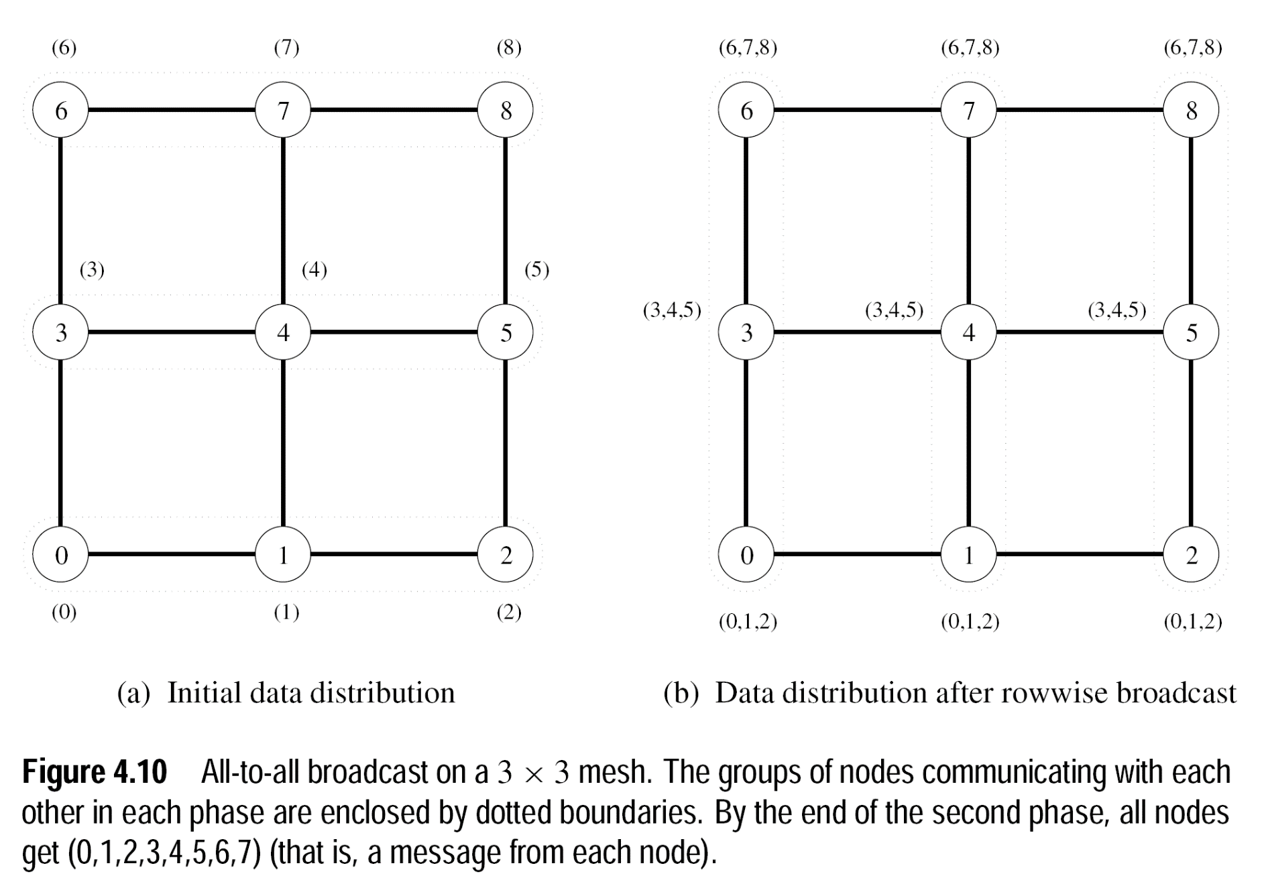
Basic Communication Operations (All-to-All Broadcast on 2D Mesh..Algorithm 4.6)
Notes:
2 phases-----
All to all in each row.
AlltoAll in each column with word size= sqrt(p) times m

Slide 11
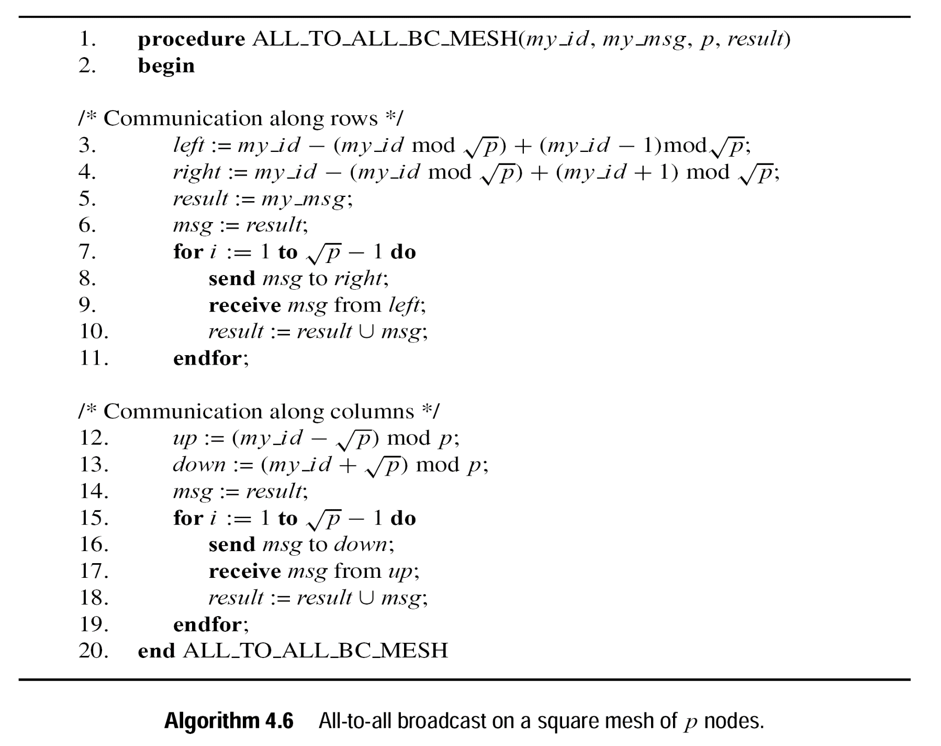
Notes:
2 phases-----
All to all in each row.
2) AlltoAll in each column with word size= sqrt(p) times m

Slide 12
Basic Communication Operations (All-to-All Broadcast on 2D Mesh..Algorithm 4.6)
Notes:
2 phases-----
All to all in each row.
AlltoAll in each column with word size= sqrt(p) times m

Slide 13
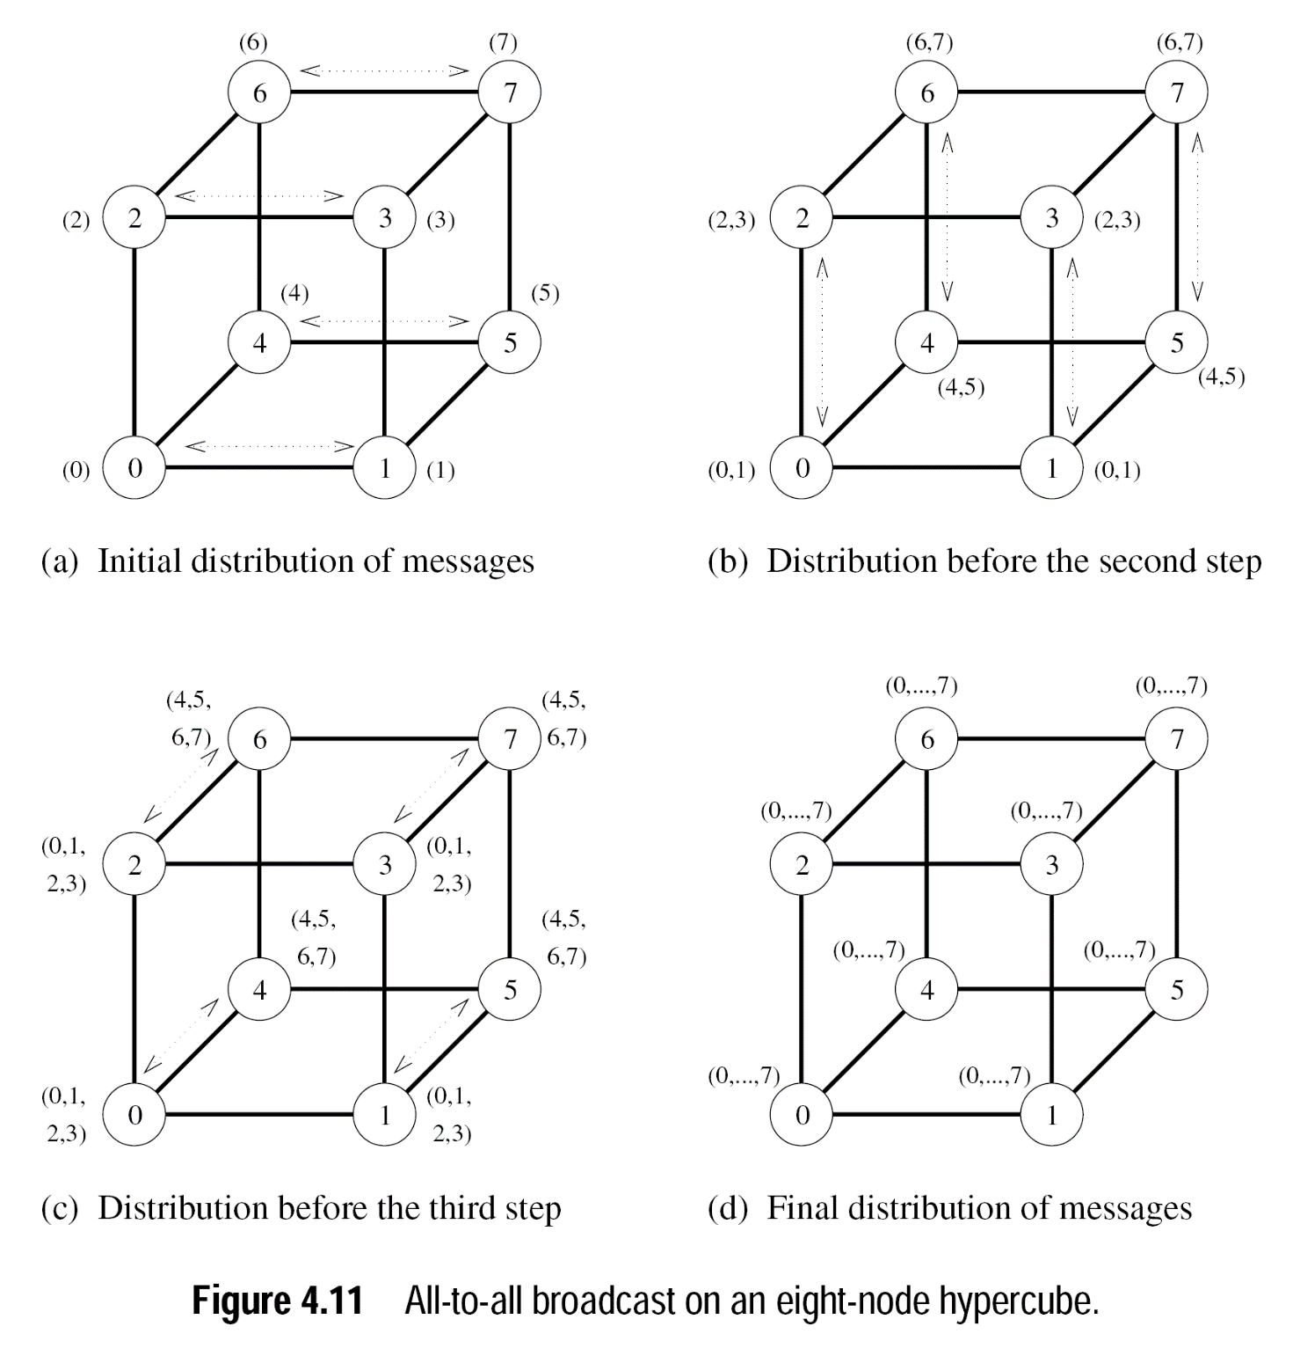
Notes:
Log p steps
→communicating nodes exchange data in each dimension
Message size doubles in every iteration
Reduction is performed by simply reversing the steps.
For example in first step: P1 will send (4,5,6,7) to P5 and P5 will send (0,1,2,3) to P1..Both reduce their contents by half

Slide 14
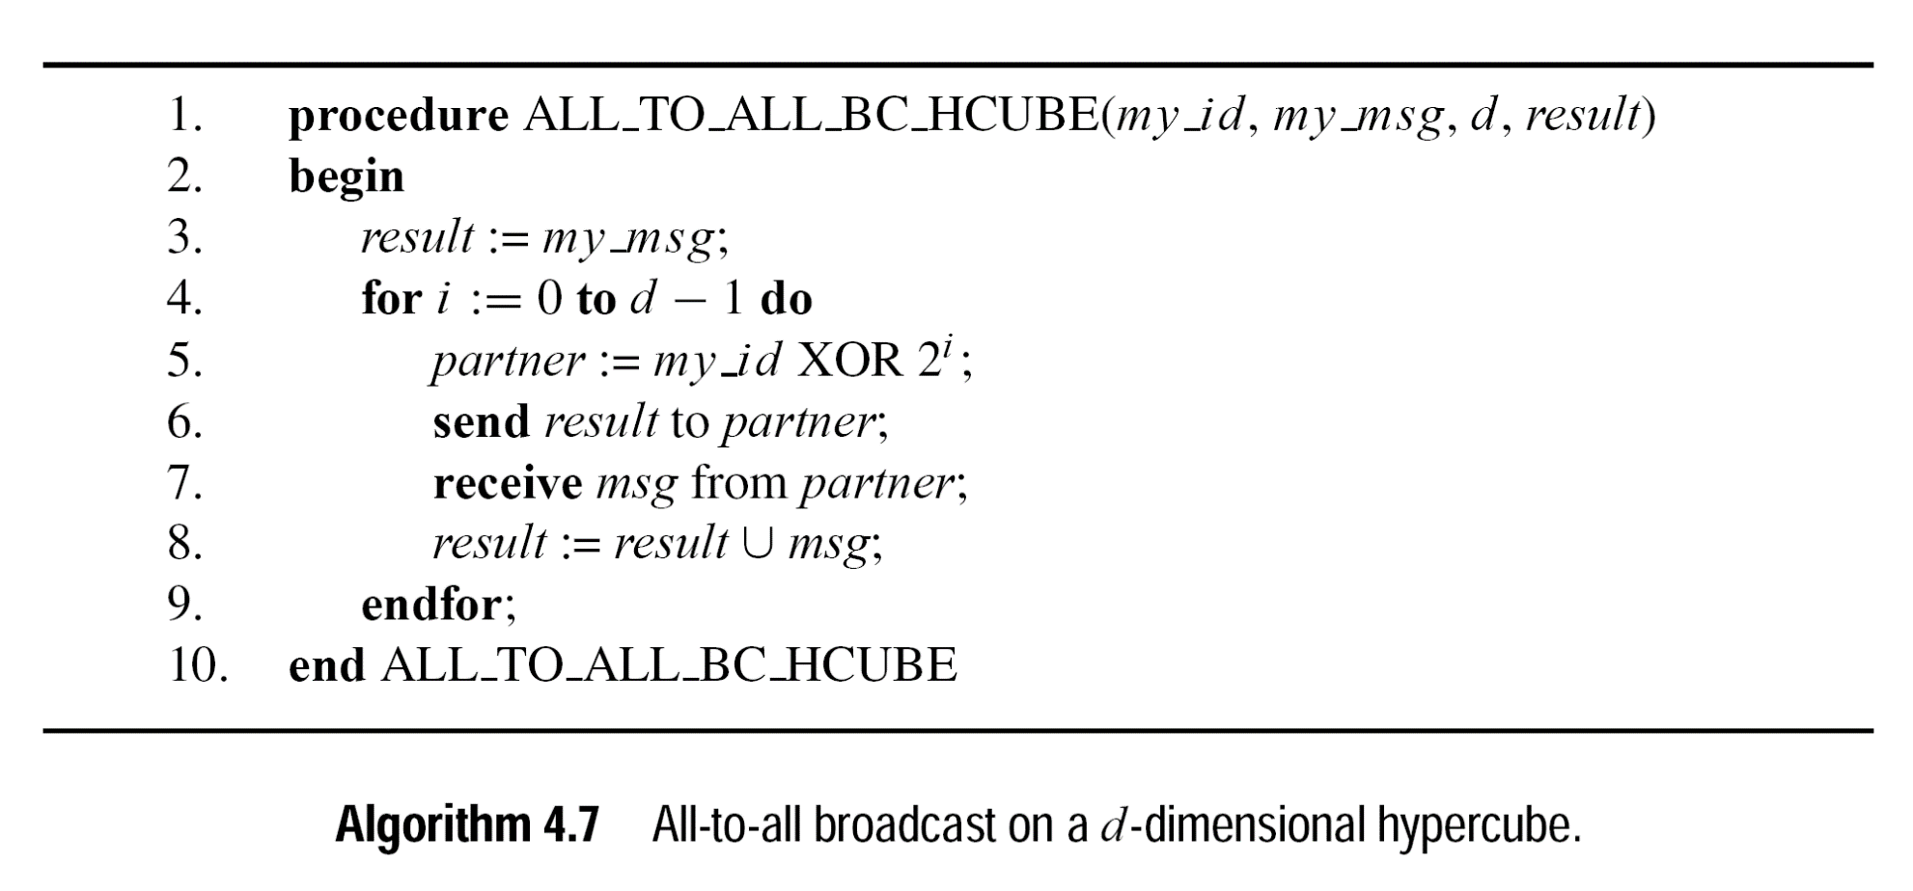
Basic Communication Operations (All-to-All Broadcast on HyperCube..Algorithm 4.6)
Notes:
Xoring an id with 2^(dimension-1) gives partner in that dimension.

Slide 15
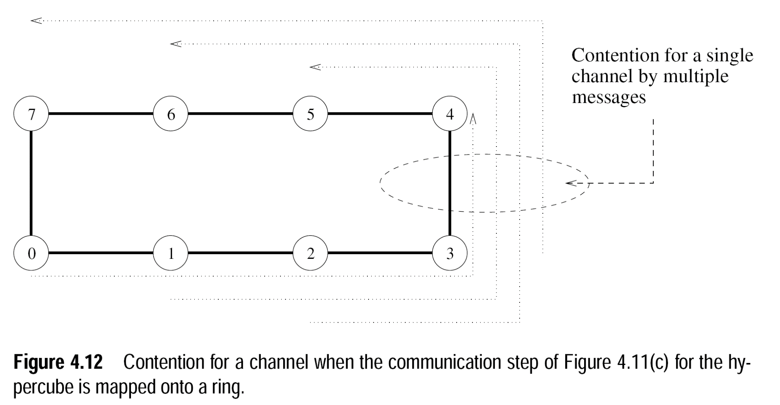
Basic Communication Operations (All-to-All Broadcast on HyperCube..Algorithm 4.6)
Same algorithm for linear ring is not possible as in one-to-all broadcast

Slide 16
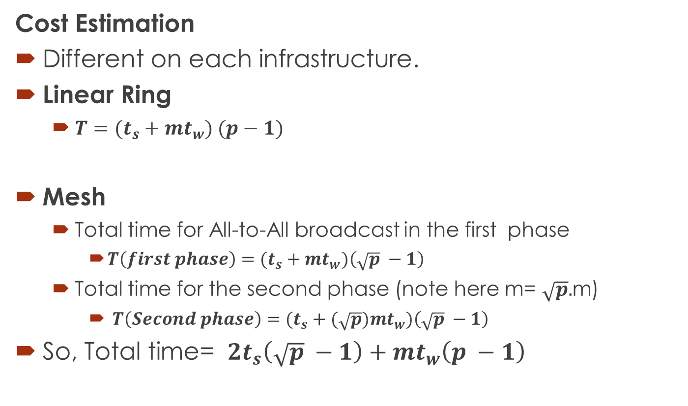
Basic Communication Operations (All-to-All Broadcast and All-to-All Reduction)
Cost Estimation
Different on each infrastructure.
Linear Ring
${T=(t}_{s}+mt_{w}) (p−1)$
Mesh
Total time for All-to-All broadcast in the first phase
${T\left(first phase\right)=(t}_{s}+mt_{w})\left(\sqrt{p} −1\right)$
Total time for the second phase (note here m= $\sqrt{p}.$m)
${T\left(Second phase\right)=(t}_{s}+(\sqrt{p})mt_{w})\left(\sqrt{p} −1\right)$
So, Total time= ${ 2t}_{s}\left(\sqrt{p} −1\right)+mt_{w}\left(p −1\right)$

Slide 17
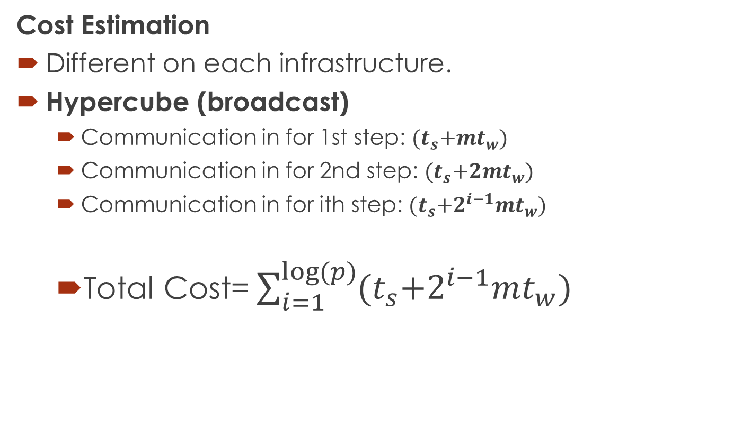
Basic Communication Operations (All-to-All Broadcast and All-to-All Reduction)
Cost Estimation
Different on each infrastructure.
Hypercube (broadcast)
Communication in for 1st step: ${(t}_{s}+mt_{w})$
Communication in for 2nd step: ${(t}_{s}+2mt_{w})$
Communication in for ith step: ${(t}_{s}+2^{i−1}mt_{w})$
Total Cost= $\sum_{i=1}^{log⁡(p)}{{(t}_{s}+2^{i−1}mt_{w})}$

Slide 18
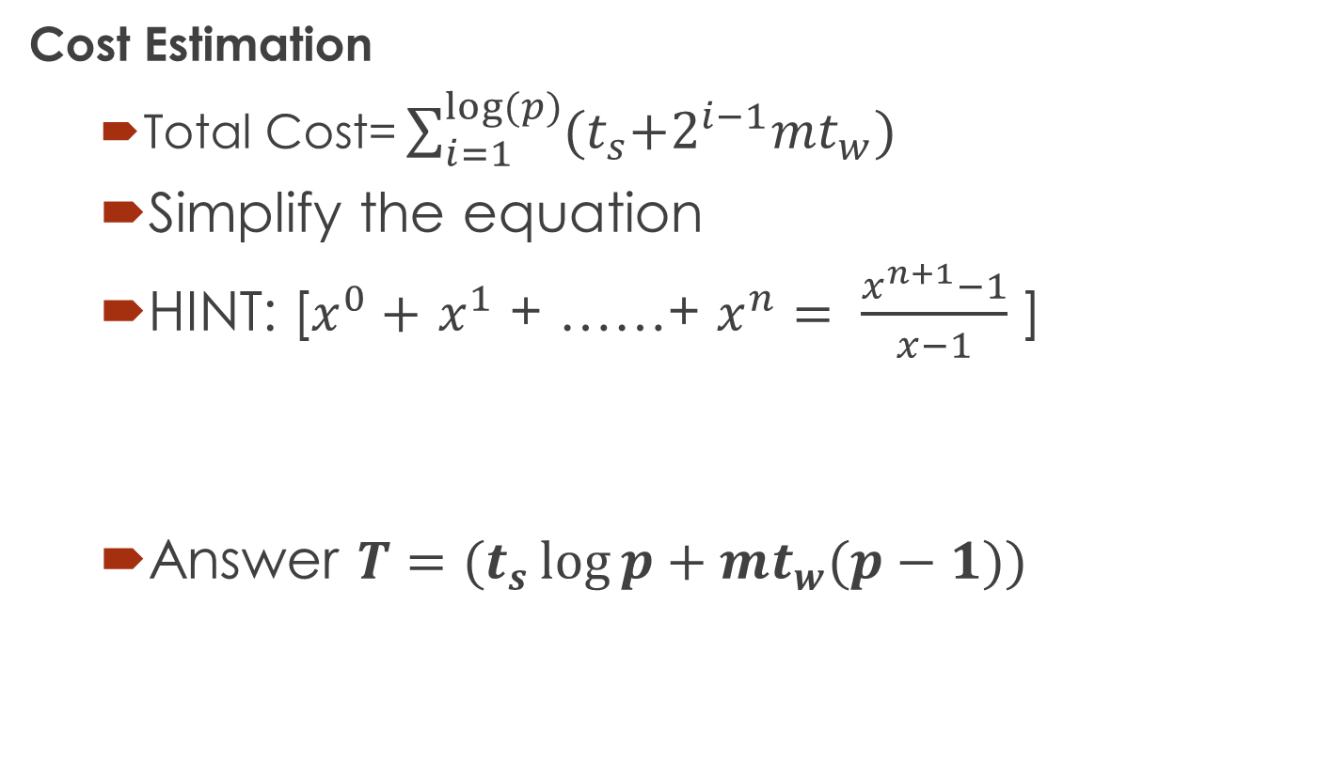
Basic Communication Operations (All-to-All Broadcast and All-to-All Reduction)
Cost Estimation
Total Cost= $\sum_{i=1}^{log⁡(p)}{{(t}_{s}+2^{i−1}mt_{w})}$
Simplify the equation
HINT: [$x^{0}+$ $x^{1}$ + ……+ $x^{n}= \frac{x^{n+1}−1}{x−1}$ ]
Answer ${T=(t}_{s}\log{p}+mt_{w}(p−1))$
Notes:
Re-write the second portion to apply the formula.

Slide 19

Questions

Slide 20
References
https://www.cs.purdue.edu/homes/ayg/book/Slides

